Slide 1

Distributed Lag Model
Farit Mochamad Afendi
08128592194 – fmafendi@apps.ipb.ac.id
Disampaikan pada:
Workshop “Analisis Statistik dengan Aplikasi R”
The Westin Hotel Jakarta
7-9 Agustus 2019

Slide 2
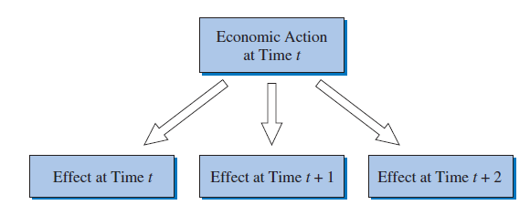



Dynamic Nature of Relationships

Slide 3
Finite Distributed Lags
Dampak X tidak dirasakan hanya seketika melainkan tersebar pada beberapa waktu
Apa yang dirasakan di Y pada suatu periode merupakan akumulasi dari dampak beberapa periode X
Kebijakan fiskal: dampak pengeluaran pemerintah atau kebijakan pajak kaitannya terhadap pengangguran dan inflasi
Kebijakan moneter: dampak suku bunga terhadap pengangguran dan inflasi
Bisnis: dampak iklan terhadap penjualan suatu perusahaan
Model di atas mengasumsikan dampak ini hanya terasa pada beberapa periode yang terbatas.

Slide 4
Finite Distributed Lags
Potensi permasalahan dalam analisis:
Berkurangnya amatan yang digunakan dalam analisis (karena lag)
Tidak ada acuan ordo q
Multikolinearitas antar peubah X
Solusi: sebaran pengaruh X terhadap Y diasumsikan mengikuti pola tertentu
Menurun geometris: Koyck
Polinomial: Almon
Autoregresi: Auto Regressive Distributed Lag

Slide 5
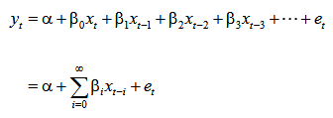


Geometric Distributed Lag
Impact multiplier:
immediate effect
Long run multiplier:
total effect

Slide 6
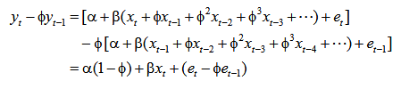

Geometric Distributed Lag
Transformasi Koyck

Slide 7


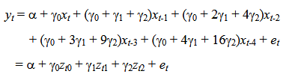
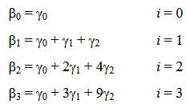
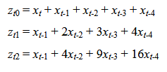

Polynomial Distributed Lag
Bila pola bobot suatu lag adalah polinomial ordo 2 (kuadratik)
Bila panjang lag = 4 maka:
Dugaan bobot menjadi:

Slide 8
Auto Regressive Distributed Lag
Polinomial DL:
Memperbaiki pendekatan finite DL dengan membuat pola bobot berupa kurva polinomial
Luwes namun tetap mengasumsikan pola tertentu dari bobot
Geometric DL:
Lag infinite tetapi menuntut pola bobot menurun geometris
ARDL menawarkan:
Struktur infinite
Keluwesan dalam pola bobot
Tetap hemat peubah dalam struktur modelnya

Slide 9

Auto Regressive Distributed Lag
ARDL(1,1): 1 lag peubah X dan 1 lag peubah Y
Secara umum: ARDL(p,q)
p lag peubah X
q lag peubah Y

Slide 10






Auto Regressive Distributed Lag

Slide 11

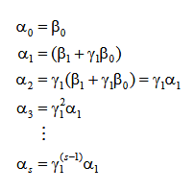
Auto Regressive Distributed Lag

Slide 12
Ilustrasi
Di data “warming” tersedia data berkaitan dengan pemanasan global
Berupa data tahunan dari 1997 hingga 2016
Terdiri dari dua peubah:
Warming: perubahan suhu global relatif terhadap rataan suhu antara 1951-1980
NoMotorVehicles: banyaknya kendaraan bermotor di seluruh dunia

Slide 13
Persiapan data dan package R
library(dLagM)
data(warming)
Str(warming)
'data.frame': 20 obs. of 3 variables:
$ Year : int 1997 1998 1999 2000 2001 2002 2003 2004 2005 2006 ...
$ NoMotorVehicles: num 54.4 53 56.3 58.4 56.3 ...
$ Warming : num 0.48 0.64 0.42 0.42 0.55 0.63 0.62 0.55 0.69 0.63 ...

Slide 14
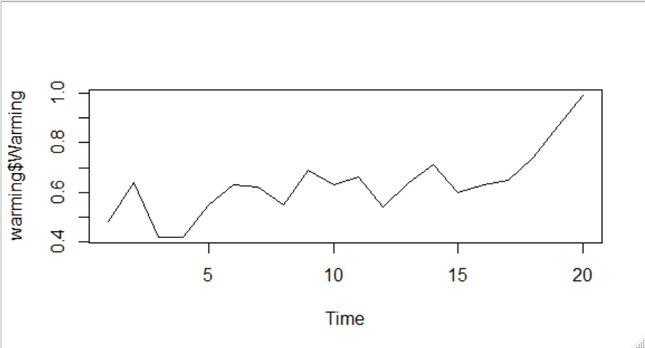
Eksplorasi
plot.ts(warming$Warming)

Slide 15
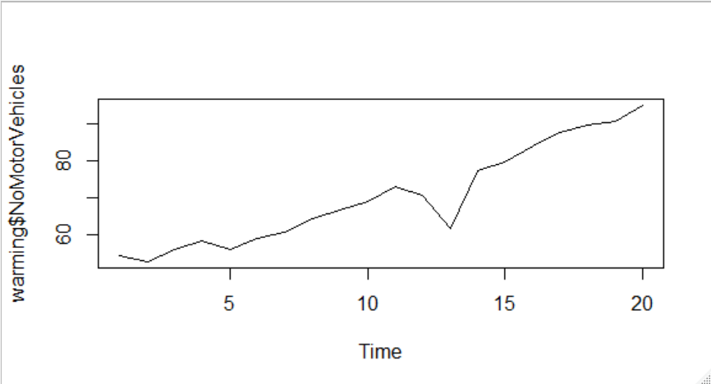
Eksplorasi
plot.ts(warming$NoMotorVehicles)

Slide 16
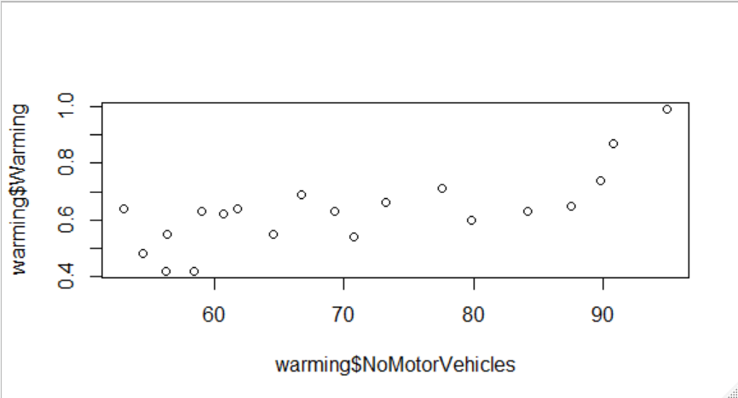
Eksplorasi
#plot antara variabel Warming dengan NoMotorVehicles
plot(warming$NoMotorVehicles,warming$Warming)

Slide 17
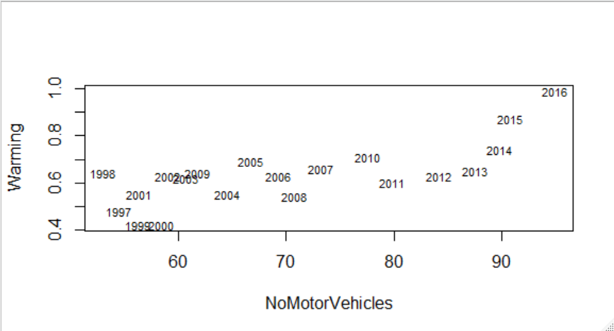
Eksplorasi
#plot antara variabel Warming dengan NoMotorVehicles (keterangan tahun)
plot(warming$NoMotorVehicles,warming$Warming,type="n",ylab="Warming", xlab="NoMotorVehicles")
text(warming$NoMotorVehicles,warming$Warming,warming$Year,cex=0.7)

Slide 18
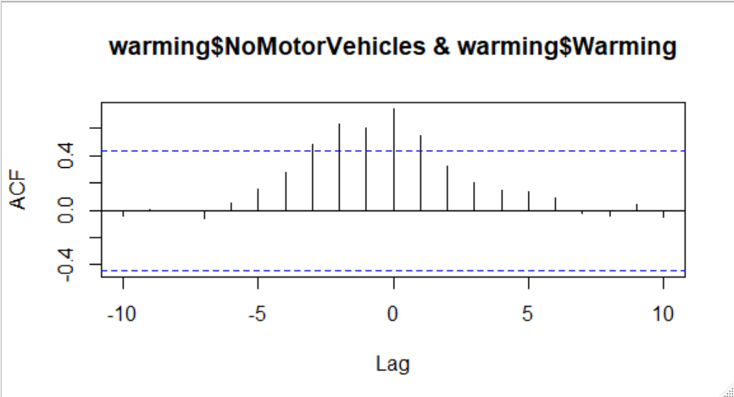
Cross-Correlation Function
Untuk melihat pola hubungan antar kedua variabel
ccf(warming$NoMotorVehicles,warming$Warming)

Slide 19
Ilustrasi – Koyck DL
model.koyck = koyckDlm(x = warming$NoMotorVehicles ,y = warming$Warming)
summary(model.koyck)
Call:
"Y ~ (Intercept) + Y.1 + X.t"
Residuals:
Min 1Q Median 3Q Max
-0.135894 -0.090056 0.003193 0.076844 0.143812
Coefficients:
Estimate Std. Error t value Pr(>|t|)
(Intercept) 0.060814 0.136314 0.446 0.6615
Y.1 0.239589 0.331208 0.723 0.4799
X.t 0.006074 0.002814 2.158 0.0464 *
---
Signif. codes: 0 ‘***’ 0.001 ‘**’ 0.01 ‘*’ 0.05 ‘.’ 0.1 ‘ ’ 1
Residual standard error: 0.09509 on 16 degrees of freedom
Multiple R-Squared: 0.5459, Adjusted R-squared: 0.4891
Wald test: 9.655 on 2 and 16 DF, p-value: 0.001777
alpha beta phi
Geometric coefficients: 0.07997527 0.006074464 0.2395892

Slide 20
Ilustrasi – Koyck DL
Coefficients:
Estimate Std. Error t value Pr(>|t|)
(Intercept) 0.060814 0.136314 0.446 0.6615
Y.1 0.239589 0.331208 0.723 0.4799
X.t 0.006074 0.002814 2.158 0.0464 *
---
Signif. codes: 0 ‘***’ 0.001 ‘**’ 0.01 ‘*’ 0.05 ‘.’ 0.1 ‘ ’ 1
Residual standard error: 0.09509 on 16 degrees of freedom
Multiple R-Squared: 0.5459, Adjusted R-squared: 0.4891
Wald test: 9.655 on 2 and 16 DF, p-value: 0.001777
alpha beta phi
Geometric coefficients: 0.07997527 0.006074464 0.2395892
Impact multiplier:
immediate effect
= 0.00607
Long run multiplier:
total effect
= 0.00607/(1-0.23959)
= 0.00799

Slide 21
Ilustrasi – Polynomial DL
model.poly = polyDlm(x = warming$NoMotorVehicles , y = warming$Warming ,
q = 2 , k = 2 , show.beta = TRUE)
Estimates and t-tests for beta coefficients:
Estimate Std. Error t value P(>|t|)
beta.0 0.00388 0.00468 0.830 0.4190
beta.1 -0.00410 0.00552 -0.742 0.4690
beta.2 0.00956 0.00488 1.960 0.0675

Slide 22
Ilustrasi – Polynomial DL
summary(model.poly)
Call:
"Y ~ (Intercept) + X.t"
Residuals:
Min 1Q Median 3Q Max
-0.108891 -0.073097 0.006059 0.046712 0.137438
Coefficients:
Estimate Std. Error t value Pr(>|t|)
(Intercept) -0.003001 0.123368 -0.024 0.981
z.t0 0.003884 0.004682 0.830 0.421
z.t1 -0.018802 0.016985 -1.107 0.287
z.t2 0.010821 0.008265 1.309 0.212
Residual standard error: 0.08586 on 14 degrees of freedom
Multiple R-squared: 0.676, Adjusted R-squared: 0.6066
F-statistic: 9.738 on 3 and 14 DF, p-value: 0.000996

Slide 23
Ilustrasi – Autoregressive DL
model.ardl = ardlDlm(x = warming$NoMotorVehicles,y = warming$Warming, p = 1, q = 1)
summary(model.ardl)
Time series regression with "ts" data:
Start = 2, End = 20
Call:
dynlm(formula = as.formula(model.text), data = data)
Residuals:
Min 1Q Median 3Q Max
-0.14169 -0.07864 0.00813 0.06984 0.14050
Coefficients:
Estimate Std. Error t value Pr(>|t|)
(Intercept) 0.051747 0.142742 0.363 0.722
X.t 0.002860 0.005457 0.524 0.608
X.1 0.002754 0.005284 0.521 0.610
Y.1 0.317368 0.316285 1.003 0.332
Residual standard error: 0.09709 on 15 degrees of freedom
Multiple R-squared: 0.5562, Adjusted R-squared: 0.4674
F-statistic: 6.266 on 3 and 15 DF, p-value: 0.005711

Slide 24
Strategi penentuan metode
Membagi data menjadi gugus data training dan testing
Membangun model untuk data training
Menerapkan model pada data testing
Membandingkan nilai MAPE

Slide 25
Gugus Data Training dan Testing
x.train<-warming$NoMotorVehicles[1:16]
y.train<-warming$Warming[1:16]
x.test<-warming$NoMotorVehicles[17:20]
y.test<-warming$Warming[17:20]
> x.train
[1] 54.43400 52.98700 56.25889 58.37416 56.30492 58.99432 60.66322 64.49622 66.71952 69.22298
[11] 73.26606 70.72970 61.76232 77.58352 79.88092 84.23617
> y.train
[1] 0.48 0.64 0.42 0.42 0.55 0.63 0.62 0.55 0.69 0.63 0.66 0.54 0.64 0.71 0.60 0.63
> x.test
[1] 87.59600 89.77647 90.78058 94.97657
> y.test
[1] 0.65 0.74 0.87 0.99

Slide 26
Membangun Model Koyck
model.koyck2 = koyckDlm(x = x.train ,y = y.train)
summary(model.koyck2)
Call:
"Y ~ (Intercept) + Y.1 + X.t"
Residuals:
Min 1Q Median 3Q Max
-0.15146 -0.04111 0.02647 0.06052 0.09196
Coefficients:
Estimate Std. Error t value Pr(>|t|)
(Intercept) 0.359016 0.181963 1.973 0.072 .
Y.1 -0.038654 0.355422 -0.109 0.915
X.t 0.003918 0.003864 1.014 0.331
---
Signif. codes: 0 ‘***’ 0.001 ‘**’ 0.01 ‘*’ 0.05 ‘.’ 0.1 ‘ ’ 1
Residual standard error: 0.08394 on 12 degrees of freedom
Multiple R-Squared: 0.1804, Adjusted R-squared: 0.0438
Wald test: 0.8998 on 2 and 12 DF, p-value: 0.4324
alpha beta phi
Geometric coefficients: 0.3456547 0.003917527 -0.03865438

Slide 27
Membangun Model Polynomial
model.poly2 = polyDlm(x = x.train, y = y.train,q = 2 , k = 2
, show.beta = TRUE)
summary(model.poly2)
Call:
"Y ~ (Intercept) + X.t"
Residuals:
Min 1Q Median 3Q Max
-0.11814 -0.05655 0.01773 0.03339 0.11292
Coefficients:
Estimate Std. Error t value Pr(>|t|)
(Intercept) 0.161557 0.189653 0.852 0.414
z.t0 0.003887 0.004347 0.894 0.392
z.t1 -0.016317 0.015707 -1.039 0.323
z.t2 0.008796 0.007650 1.150 0.277
Residual standard error: 0.07883 on 10 degrees of freedom
Multiple R-squared: 0.385, Adjusted R-squared: 0.2005
F-statistic: 2.087 on 3 and 10 DF, p-value: 0.1657

Slide 28
Membangun Model Autoregressive
model.ardl2 = ardlDlm(x = x.train, y = y.train,p = 1 , q = 1 )
summary(model.ardl2)
Time series regression with "ts" data:
Start = 2, End = 16
Call:
dynlm(formula = as.formula(model.text), data = data)
Residuals:
Min 1Q Median 3Q Max
-0.15343 -0.04160 0.02766 0.06292 0.09338
Coefficients:
Estimate Std. Error t value Pr(>|t|)
(Intercept) 0.3599077 0.1937227 1.858 0.0901 .
X.t 0.0045091 0.0050864 0.887 0.3943
X.1 -0.0004644 0.0050953 -0.091 0.9290
Y.1 -0.0561220 0.3336043 -0.168 0.8695
---
Signif. codes: 0 ‘***’ 0.001 ‘**’ 0.01 ‘*’ 0.05 ‘.’ 0.1 ‘ ’ 1
Residual standard error: 0.08762 on 11 degrees of freedom
Multiple R-squared: 0.1814, Adjusted R-squared: -0.04185
F-statistic: 0.8126 on 3 and 11 DF, p-value: 0.5132

Slide 29
Menerapkan Model dan Membandingkan MAPE
#forecast data testing
fore.koyck2 <- forecast(model=model.koyck2, x=x.test,h=4)
fore.poly2 <- forecast(model=model.poly2, x=x.test,h=4)
fore.ardl2 <- forecast(model=model.ardl2, x=x.test,h=4)
#### MAPE (y_pred, y_true)
MAPE(fore.koyck2$forecasts,y.test)
MAPE(fore.poly2$forecasts,y.test)
MAPE(fore.ardl2$forecasts,y.test)
> MAPE(fore.koyck2$forecasts,y.test)
[1] 0.1537885
> MAPE(fore.poly2$forecasts,y.test)
[1] 0.1122052
> MAPE(fore.ardl2$forecasts,y.test)
[1] 0.15336

Slide 30
Plot
plot(warming$NoMotorVehicles[17:20],warming$Warming[17:20],type=“o",
ylab="Warming",xlab="NoMotorVehicles",col="blue")
points(warming$NoMotorVehicles[17:20],fore.koyck2$forecasts,col="red")
lines(warming$NoMotorVehicles[17:20],fore.koyck2$forecasts,col="red")
points(warming$NoMotorVehicles[17:20],fore.poly2$forecasts,col="black")
lines(warming$NoMotorVehicles[17:20],fore.poly2$forecasts,col="black")
points(warming$NoMotorVehicles[17:20],fore.ardl2$forecasts,col="green",pch="+")
lines(warming$NoMotorVehicles[17:20],fore.ardl2$forecasts,col="green",)
legend(87.5, 1, legend=c("aktual", "polynomial","koyck","autoreg"),
col=c("blue", "black","red","green"), lty=1, cex=0.8,
box.lty=0)

Slide 31
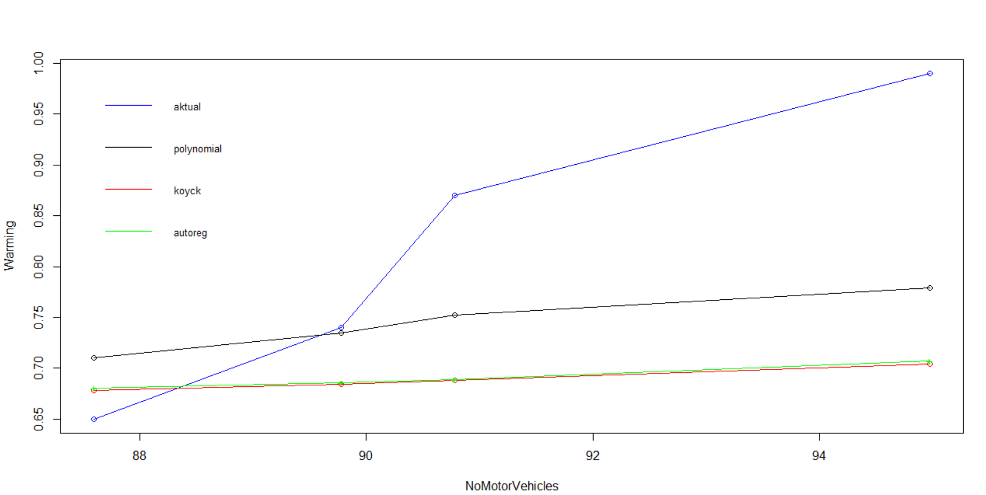
Plot

Slide 32
Plot – ggplot2
warming_test <- warming[17:20,]
warming_test$koyck <- fore.koyck2$forecasts
warming_test$poly <- fore.poly2$forecasts
warming_test$adrl <- fore.ardl2$forecasts
ggplot(data = warming_test, mapping = aes(x = NoMotorVehicles)) +
geom_line(mapping = aes(y = Warming, color = "aktual")) +
geom_point(mapping = aes(y = Warming), color = "blue") +
geom_line(mapping = aes(y = koyck, color = "koyck")) +
geom_point(mapping = aes(y = koyck), color = "red") +
geom_line(mapping = aes(y = poly, color = "poly")) +
geom_point(mapping = aes(y = poly), color = "black") +
geom_line(mapping = aes(y = adrl, color = "adrl")) +
geom_point(mapping = aes(y = adrl), color = "green") +
scale_color_manual("Legend",
values = c("aktual" = "blue",
"koyck" = "red",
"poly" = "black",
"adrl" = "green"))

Slide 33
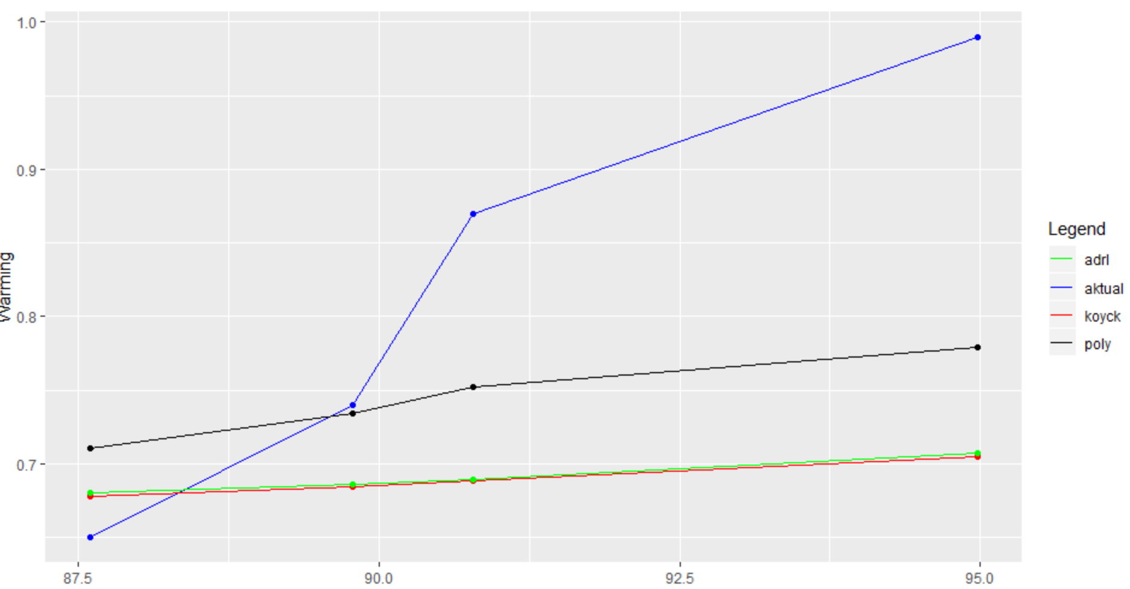
Plot – ggplot2

Slide 34
Terima Kasih

